Slide 1

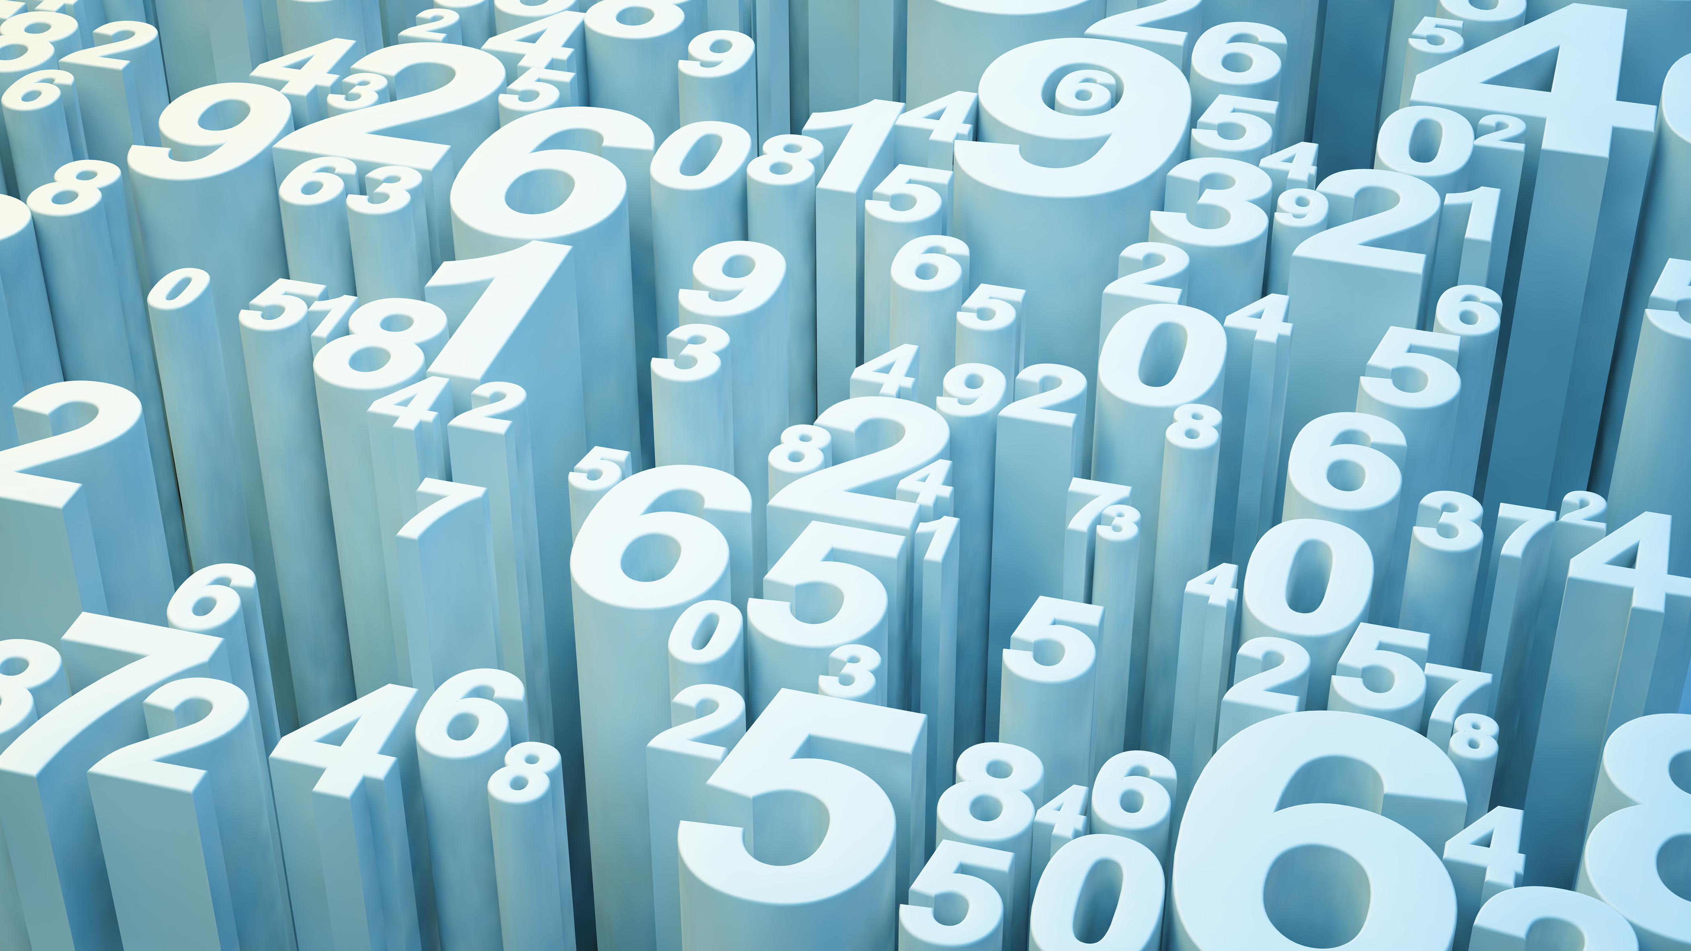
NumPy, Broadcasting and Matplotlib
Week 5

Slide 2
Capstone Idea & Rough Draft

Slide 3
What is NumPy?
Definition
Numerical Python
A Module
Open source and used in almost every field of science and engineering.
Used With
Pandas, SciPy, Matplotlib,
Scikit-learn, scikit-image and other data science/science Python packages.
A universal standard

Slide 4
What it does
It contains a multidimensional array and matrix data structures
Provides a ndarray (a homogeneous n-dimensional array object) with methods to efficiently operate on it.
Performs a wide variety of mathematical operations on arrays.
Adds powerful data structures to Python that guarantee efficient calculations with arrays and matrices
Supplies an enormous library of high-level mathematical functions that operate on these arrays and matrices.

Slide 5
All about Arrays
Usually a fixed-size container of items of the same type and size.
The number of dimensions and items in an array is defined by its shape.
The shape is a tuple of non-negative integers that specify the sizes of each dimension.
The rank of the array is the number of dimensions.
A central data structure of the NumPy library.
A grid of values and it contains information about raw data, how to locate an element and how to interpret it.
The grid has elements that can be indexed in various ways.
The elements are all the same, referred to as the array dtype

Slide 6
Biggest difference between Python lists and NumPy arrays: NumPy arrays are homogeneous
Of the same or a similar
kind or nature

Slide 7
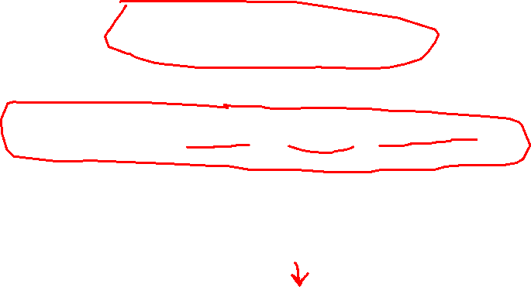
One way to initialize NumPy arrays
a = np.array([1, 2, 3, 4, 5, 6])
Or
a = np.array([[1,2,3,4], [5,6,7,8],[9,10,11,12]])
Access elements by starting with element “0”
print(a[0])
[1 2 3 4]

Slide 8
Useful keywords
Ndarray = N-dimensional array
1-D = one dimensional array
2-D = two-dimensional array
Vector = an array with a single dimension
Matrix = an array with two dimensions
Tensor = an array with 3+ dimensions
Dimensions = axes
[[0., 0., 0.], [1., 1., 1.]]
2-D array
2 axes
First axis: length of 2
Second axis: length of 3

Slide 9
Create a file in vscode & name it: week5
You need to install it
You can import 2 ways
In your terminal, type
pip install numpy
import numpy
import numpy as np
Depends on what you need to do.

Slide 10
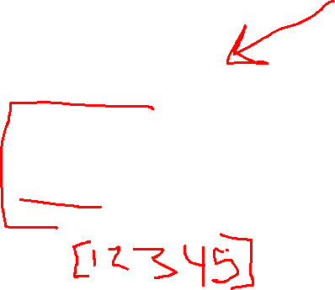
Creating arrays
zeros
General
import numpy as np
b = np.zeros(4)
print(b)
import numpy
a = numpy.array([1, 2, 3, 4, 5])
print(a)
ones
import numpy as np
c = np.ones(2)
print(c)

Slide 11
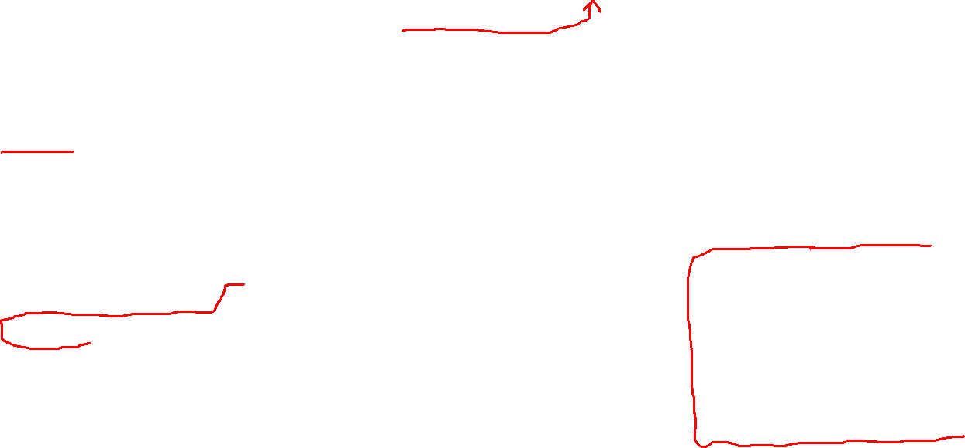
empty
range
import numpy as np
d = np.empty(3)
print(d)
**Creates an array whole initial content is random and depends on the state of memory. ** Speed.
import numpy as np
e = np.arange(5)
print(e)
Contains a range of evenly spaced intervals
import numpy as np
f = np.arange(2, 9, 2)
print(f)

Slide 12
With values that are spaced linearly in a specified interval
import numpy as np
g = np.linspace(0, 10, num=5)
print(g)
Contains a range of evenly spaced intervals
import numpy as np
f = np.arange(2, 9, 2)
print(f)

Slide 13
Sorting
import numpy as np
arr = np.array([2, 1, 5, 3, 7, 4, 6, 8])
a = np.sort(arr)
print(a)
Other commands
argsort = an indirect sort along a specified axis
lexsort = an indirect stable sort on multiple keys
searchsorted = will find elements in a sorted array
partition = partial sort

Slide 14

Concatenation
import numpy as np
a = np.array([1, 2, 3, 4])
b = np.array([5, 6, 7, 8])
arr = np.concatenate((a, b))
print(arr)
import numpy as np
x = np.array([[1, 2], [3, 4]])
y = np.array([[5, 6]])
arr = np.concatenate((x, y), axis=0)
print(arr)

Slide 15
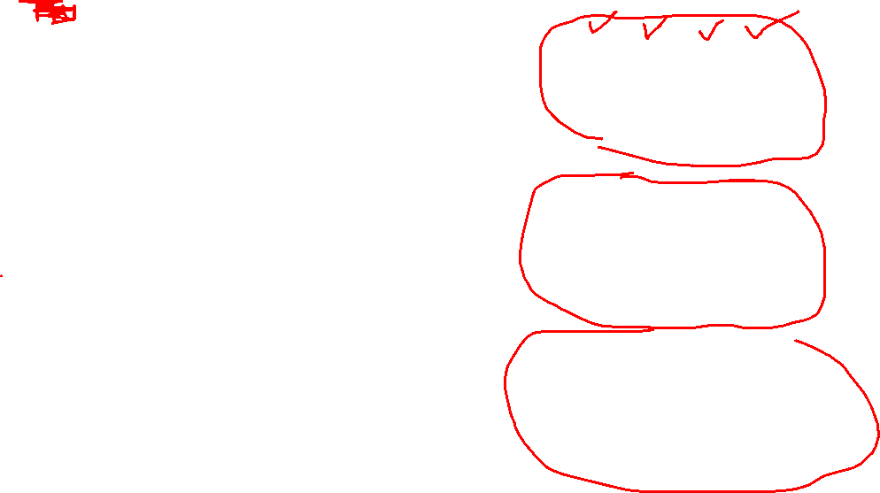
Knowing shape and size
array_example = np.array([[[0, 1, 2, 3],
[4, 5, 6, 7]],
[[0, 1, 2, 3],
[4, 5, 6, 7]],
[[0 ,1 ,2, 3],
[4, 5, 6, 7]]])

Slide 16
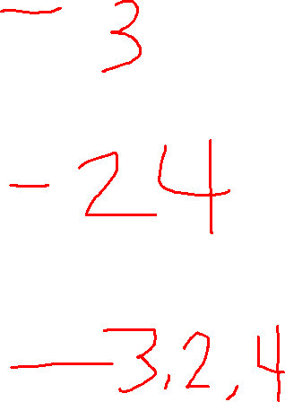
t = array_example.ndim
print(t)
u = array_example.size
print(u)
v = array_example.shape
print(v)

Slide 17
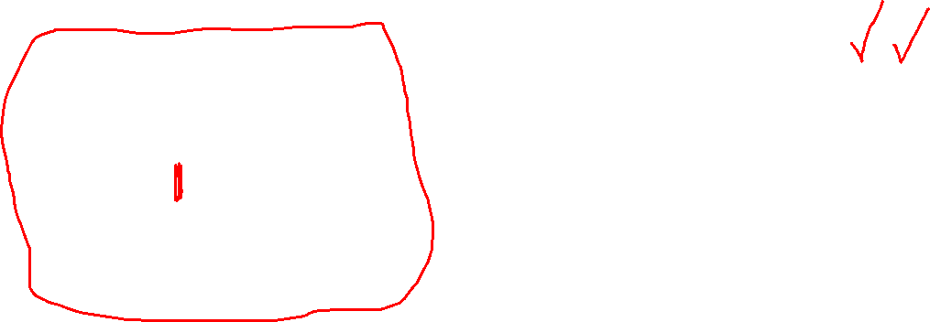
Reshaping
Start with this:
Change it:
import numpy as np
a = np.arrange(6)
print(a)
b = a.reshape(3, 2)
print(b)

Slide 18
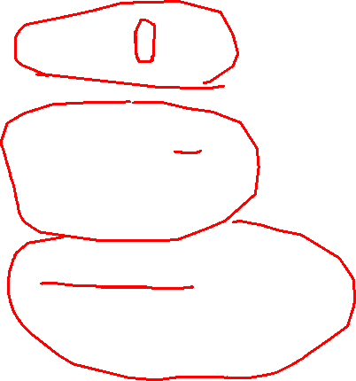
Indexing and Slicing
import numpy as np
data = np.array([1, 2, 3])
a = data[1]
b = data[0:2]
c = data[1:]
d = data[-2:]
print(a)
print(b)
print(c)
print(d)
import numpy as np
a = np.array([[1 , 2, 3, 4], [5, 6, 7, 8], [9, 10, 11, 12]])
print(a[a < 5])
five_up = (a >= 5)
print(a[five_up])
divisible_by_2 = a[a%2==0]
print(divisible_by_2)

Slide 19
Other functions
Can use “&” and “|” to get Booleans
np.nonzero() = select elements or indices from an array
np.vstack() = stack vertically
np.hstack() = stack horizontally
np.hsplit() = split arrays
.view() = create new array object that looks at same data as the original array
copy() = complete copy of the array and its data.
Addition/Substraction
Multiplication/Division
Max/min
Sum/mean
Product
Standard diviation

Slide 20
Broadcasting
A mechanism for performing math operations on arrays of unequal shapes
To determine if two arrays are broadcast-compatible, align the entries of their shapes such that their trailing dimensions are aligned, and then check that each pair of aligned dimensions satisfy either of the following conditions:
the aligned dimensions have the same size
one of the dimensions has a size of 1
The two arrays are broadcast-compatible if either of these conditions are satisfied for each pair of aligned dimensions.

Slide 21
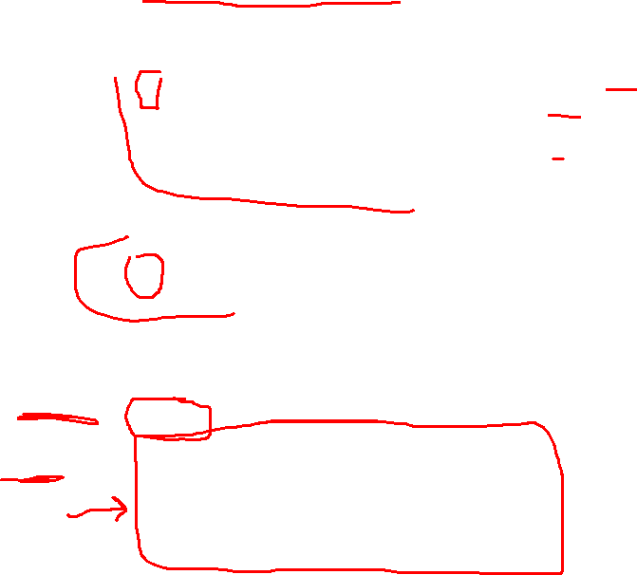
import numpy as np
# a shape-(3, 4) array
x = np.array([[-0. , -0.1, -0.2, -0.3],
[-0.4, -0.5, -0.6, -0.7],
[-0.8, -0.9, -1. , -1.1]])
# a shape-(4,) array
y = np.array([1, 2, 3, 4])
# multiplying a shape-(4,) array with a shape-(3, 4) array
# `y` is multiplied by each row of `x`
x * y
array([[-0. , -0.2, -0.6, -1.2],
[-0.4, -1. , -1.8, -2.8],
[-0.8, -1.8, -3. , -4.4]])

Slide 22
Matplotlib
A comprehension library for creating static, animated and interactive visualizations in Python.
Makes easy things easy and hard things possible.
Create publication quality plots
Make interactive figures that can zoom, pan and update.
Customize visual style and layout
Export to many file formats
Embed in JupyterLab and Graphical User Interfaces
Use a rich array of third-party packages built on it.

Slide 23
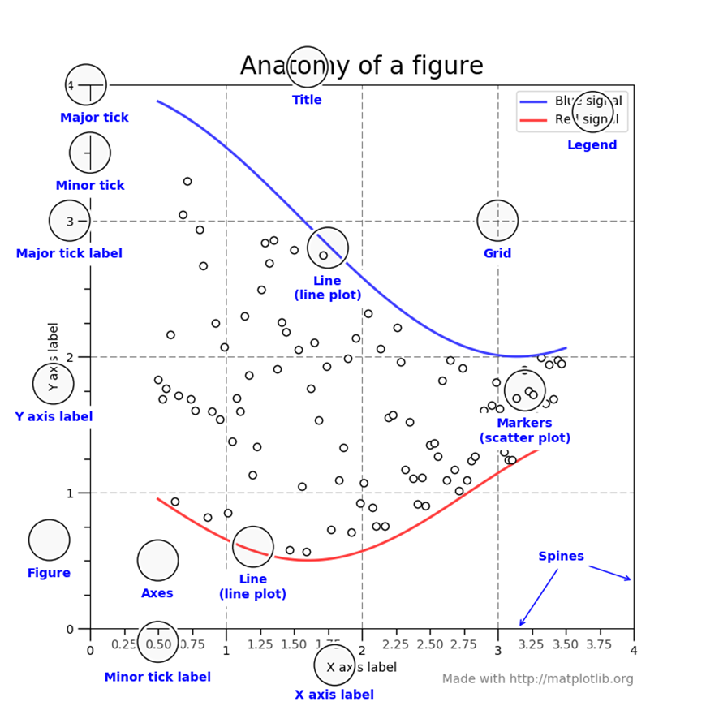
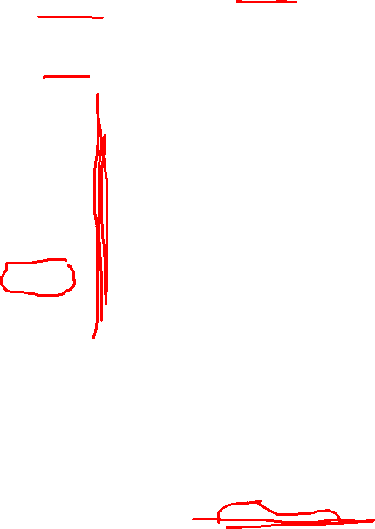

Slide 24
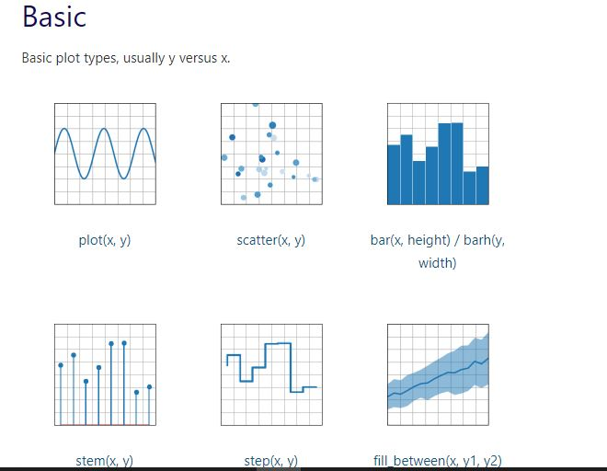
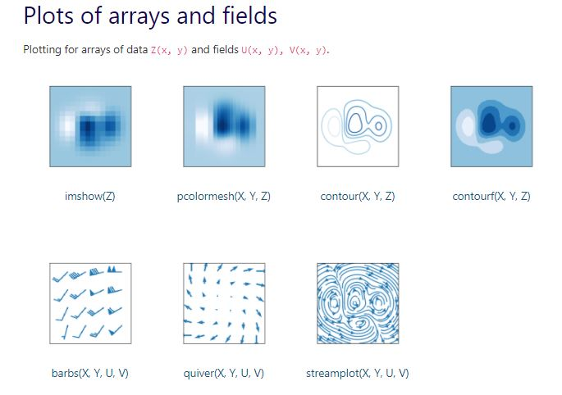

Types of Visuals

Slide 25
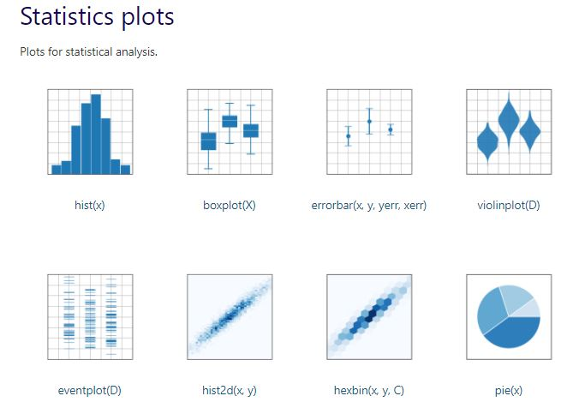
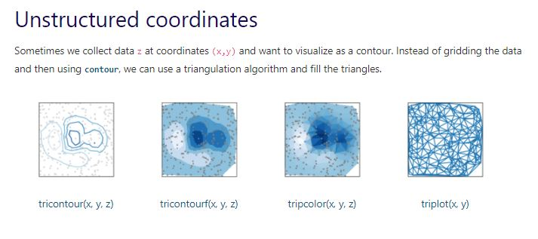

Slide 26
ALSO – pip install jupyter notebook
You need to install it
You need to import it
In your terminal, type
pip install matplotlib
import matplotlib.pyplot as plt
import numpy as np

Slide 27
What is Jupyter Notebook?
The notebook extends the console-based approach to interactive computing in a qualitatively new direction, providing a web-based application suitable for capturing the whole computation process: developing, documenting, and executing code, as well as communicating the results. The Jupyter notebook combines two components:
A web application: a browser-based tool for interactive authoring of documents which combine explanatory text, mathematics, computations and their rich media output.
Notebook documents: a representation of all content visible in the web application, including inputs and outputs of the computations, explanatory text, mathematics, images, and rich media representations of objects.

Slide 28
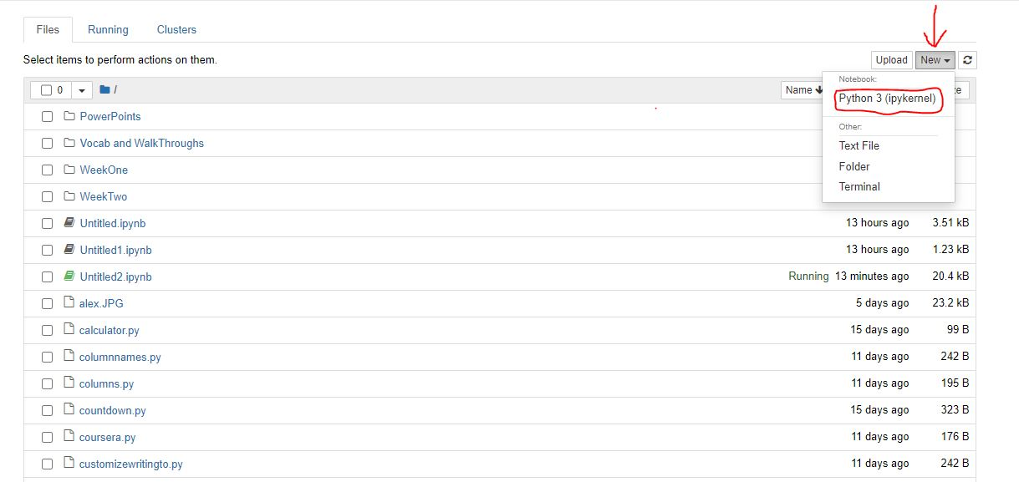
How to start the Jupyter Notebook Server
Type in jupyter notebook in your terminal and press enter

Slide 29
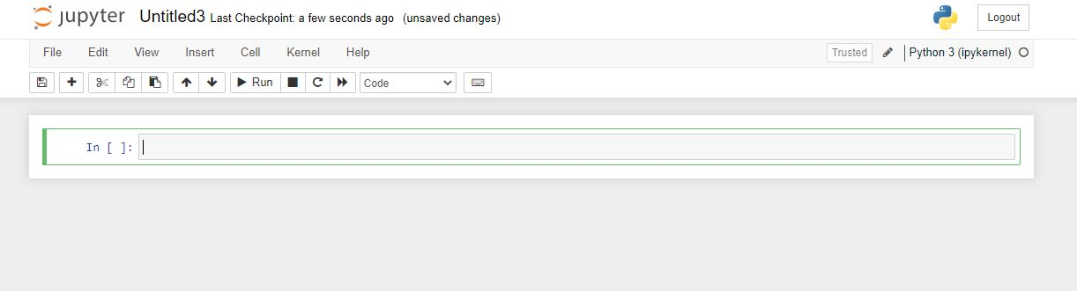
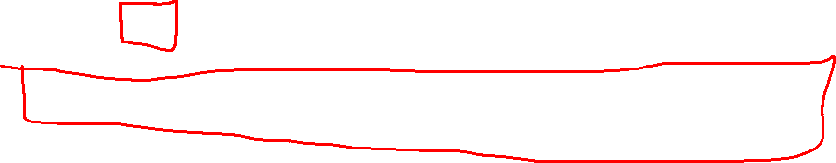

Slide 30
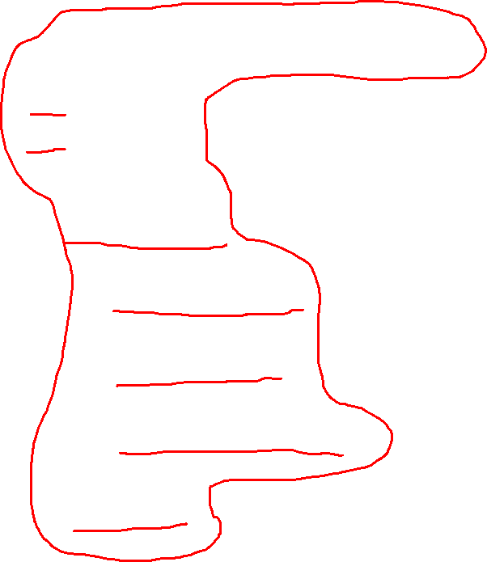
Example One your first graph
import matplotlib.pyplot as plt
x = [1,2,3] # x axis values
y = [2,4,1] # corresponding y axis values
plt.plot(x, y) # plotting the points
plt.xlabel('x - axis') # naming the x axis
plt.ylabel('y - axis') # naming the y axis
plt.title('My first graph!') # giving a title to my graph
plt.show() # function to show the plot

Slide 31
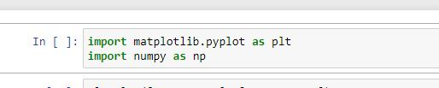
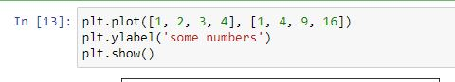
Example Two

Slide 32
Open VSCode make sure you are in the right directory initialize jupyter notebook

Slide 33
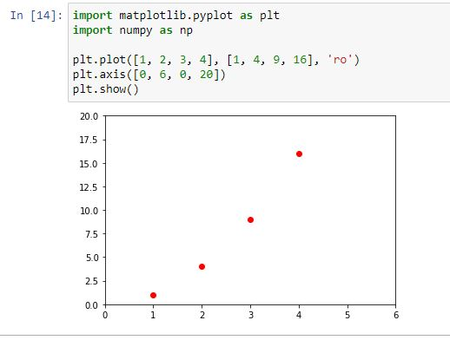
Example Three

Slide 34
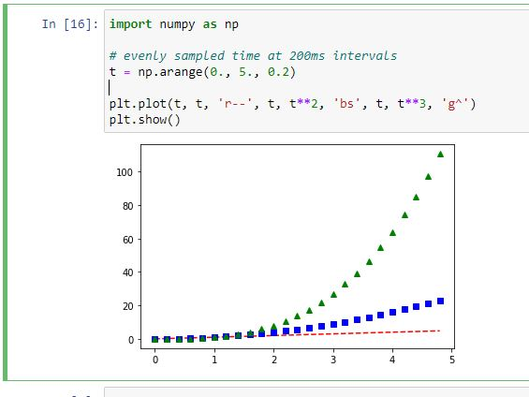
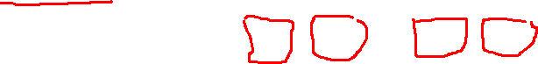
Example Four

Slide 35
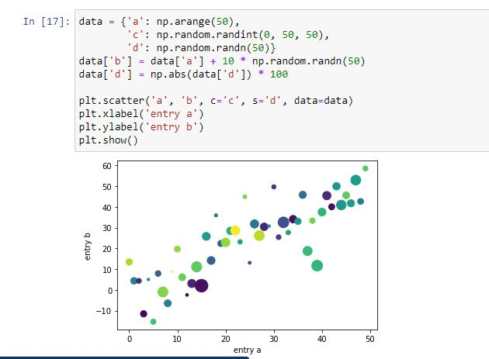
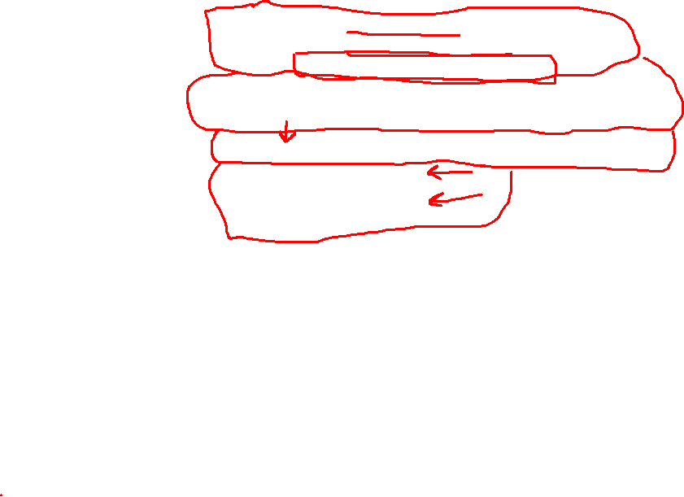
Example Five

Slide 36
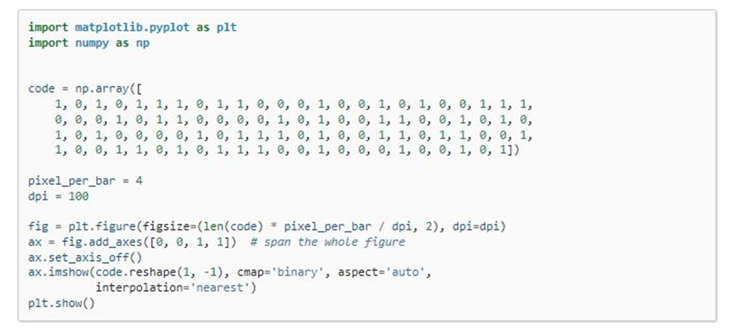
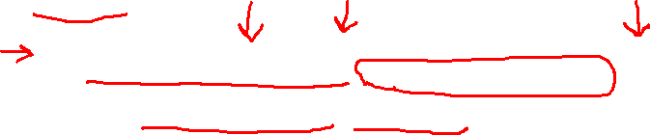
Example Six

Slide 37
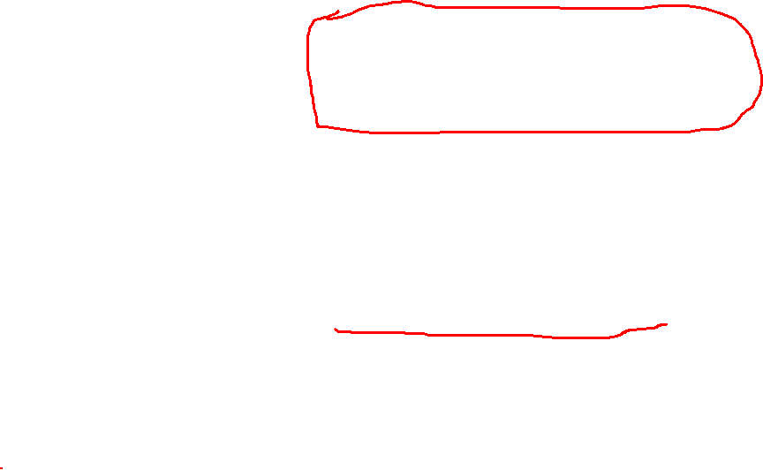
Example Seven
import matplotlib.pyplot as plt
a = [1, 2, 3, 4, 5]
b = [0, 0.6, 0.2, 15, 10, 8, 16, 21]
plt.plot(a)
# o is for circles and r is
# for red
plt.plot(b, "or")
plt.plot(list(range(0, 22, 3)))
# naming the x-axis
plt.xlabel('Day ->')
# naming the y-axis
plt.ylabel('Temp ->')

Slide 38
c = [4, 2, 6, 8, 3, 20, 13, 15]
plt.plot(c, label = '4th Rep')
ax = plt.gca() # get current axes command
# get command over the individual
# boundary line of the graph body
ax.spines['right'].set_visible(False)
ax.spines['top'].set_visible(False)
# set the range or the bounds of
# the left boundary line to fixed range
ax.spines['left'].set_bounds(-3, 40)
# set the interval by which
# the x-axis set the marks
plt.xticks(list(range(-3, 10)))

Slide 39

# set the intervals by which y-axis
# set the marks
plt.yticks(list(range(-3, 20, 3)))
# legend denotes that what color
# signifies what
ax.legend(['1st Rep', '2nd Rep', '3rd Rep', '4th Rep'])
# annotate command helps to write
# ON THE GRAPH any text xy denotes
# the position on the graph
plt.annotate('Temperature V / s Days', xy = (1.01, -2.15))
# gives a title to the Graph
plt.title('All Features Discussed')
plt.show()

Slide 40
import matplotlib.pyplot as plt
a = [1, 2, 3, 4, 5]
b = [0, 0.6, 0.2, 15, 10, 8, 16, 21]
c = [4, 2, 6, 8, 3, 20, 13, 15]
# use fig whenever u want the
# output in a new window also
# specify the window size you
# want ans to be displayed
fig = plt.figure(figsize =(10, 10))
Example
Eight

Slide 41
# creating multiple plots in a
# single plot
sub1 = plt.subplot(2, 2, 1)
sub2 = plt.subplot(2, 2, 2)
sub3 = plt.subplot(2, 2, 3)
sub4 = plt.subplot(2, 2, 4)
sub1.plot(a, 'sb')
# sets how the display subplot
# x axis values advances by 1
# within the specified range
sub1.set_xticks(list(range(0, 10, 1)))
sub1.set_title('1st Rep')
sub2.plot(b, 'or')

Slide 42
# sets how the display subplot x axis
# values advances by 2 within the
# specified range
sub2.set_xticks(list(range(0, 10, 2)))
sub2.set_title('2nd Rep')
# can directly pass a list in the plot
# function instead adding the reference
sub3.plot(list(range(0, 22, 3)), 'vg')
sub3.set_xticks(list(range(0, 10, 1)))
sub3.set_title('3rd Rep')

Slide 43
sub4.plot(c, 'Dm')
# similarly we can set the ticks for
# the y-axis range(start(inclusive),
# end(exclusive), step)
sub4.set_yticks(list(range(0, 24, 2)))
sub4.set_title('4th Rep')
# without writing plt.show() no plot
# will be visible
plt.show()

Slide 44
import matplotlib.pyplot as plt
# line 1 points
x1 = [1,2,3]
y1 = [2,4,1]
# plotting the line 1 points
plt.plot(x1, y1, label = "line 1")
# line 2 points
x2 = [1,2,3]
y2 = [4,1,3]
# plotting the line 2 points
plt.plot(x2, y2, label = "line 2")
Example
Nine

Slide 45
# naming the x axis
plt.xlabel('x - axis')
# naming the y axis
plt.ylabel('y - axis')
# giving a title to my graph
plt.title('Two lines on same graph!')
# show a legend on the plot
plt.legend()
# function to show the plot
plt.show()

Slide 46
Example
Ten
import matplotlib.pyplot as plt
# x axis values
x = [1,2,3,4,5,6]
# corresponding y axis values
y = [2,4,1,5,2,6]
# plotting the points
plt.plot(x, y, color='green', linestyle='dashed', linewidth = 3,
marker='o', markerfacecolor='blue', markersize=12)

Slide 47
# setting x and y axis range
plt.ylim(1,8)
plt.xlim(1,8)
# naming the x axis
plt.xlabel('x - axis')
# naming the y axis
plt.ylabel('y - axis')
# giving a title to my graph
plt.title('Some cool customizations!')
# function to show the plot
plt.show()

Slide 48
Example
Eleven
import matplotlib.pyplot as plt
# x-coordinates of left sides of bars
left = [1, 2, 3, 4, 5]
# heights of bars
height = [10, 24, 36, 40, 5]
# labels for bars
tick_label = ['one', 'two', 'three', 'four', 'five']

Slide 49
# plotting a bar chart
plt.bar(left, height, tick_label = tick_label,
width = 0.8, color = ['red', 'green'])
# naming the x-axis
plt.xlabel('x - axis')
# naming the y-axis
plt.ylabel('y - axis')
# plot title
plt.title('My bar chart!')
# function to show the plot
plt.show()

Slide 50
Example
Twelve
import matplotlib.pyplot as plt
# frequencies
ages = [2,5,70,40,30,45,50,45,43,40,44,
60,7,13,57,18,90,77,32,21,20,40]
# setting the ranges and no. of intervals
range = (0, 100)
bins = 10
# plotting a histogram
plt.hist(ages, bins, range, color = 'green',
histtype = 'bar', rwidth = 0.8)

Slide 51
# x-axis label
plt.xlabel('age')
# frequency label
plt.ylabel('No. of people')
# plot title
plt.title('My histogram')
# function to show the plot
plt.show()

Slide 52
import matplotlib.pyplot as plt
activities = ['eat', 'sleep', 'work', 'play’] # defining labels
slices = [3, 7, 8, 6] # portion covered by each label
colors = ['r', 'y', 'g', 'b’] # color for each label
# plotting the pie chart
plt.pie(slices, labels = activities, colors=colors,
startangle=90, shadow = True, explode = (0, 0, 0.1, 0),
radius = 1.2, autopct = '%1.1f%%')
plt.legend() # plotting legend
plt.show() # showing the plot
Example
Thirteen

Slide 53
# importing the required modules
import matplotlib.pyplot as plt
import numpy as np
# setting the x - coordinates
x = np.arange(0, 2*(np.pi), 0.1)
# setting the corresponding y - coordinates
y = np.sin(x)
# plotting the points
plt.plot(x, y)
# function to show the plot
plt.show()
Example
Fourteen

Slide 54
import matplotlib.pyplot as plt
import numpy as np
ypoints = np.array([3, 8, 1, 10, 5, 7])
plt.plot(ypoints)
plt.show()
Example
Fifteen

Slide 55
Draw a line in a diagram from position (1, 3) to position (8,10)
import matplotlib.pyplot as plt
import numpy as np
xpoints = np.array([1, 8])
ypoints = np.array([3,10])
plt.plot(xpoints, ypoints)
plt.show()

Slide 56
Draw 2 points in a diagram from position (1, 3) to position (8,10)
import matplotlib.pyplot as plt
import numpy as np
xpoints = np.array([1, 8])
ypoints = np.array([3,10])
plt.plot(xpoints, ypoints, ‘o’)
plt.show()

Slide 57
Draw a line in a diagram from position (1, 3) to (2, 8) then to (6, 1) and finally to position (8,10)
import matplotlib.pyplot as plt
import numpy as np
xpoints = np.array([1, 8])
ypoints = np.array([3,10])
plt.plot(xpoints, ypoints, ‘o’)
plt.show()

Slide 58
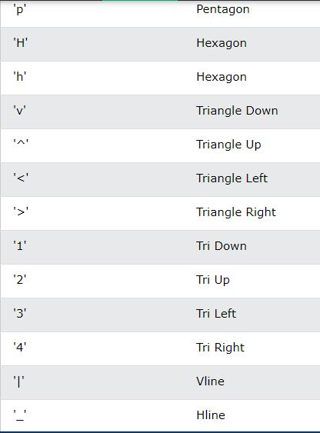
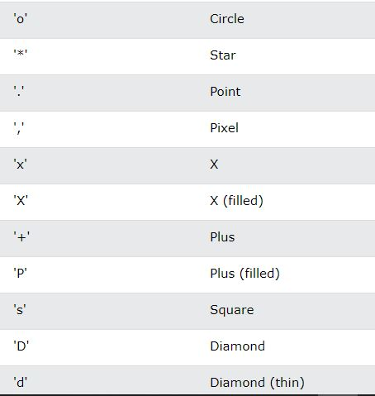
Customize – Customize - Customize

Slide 59
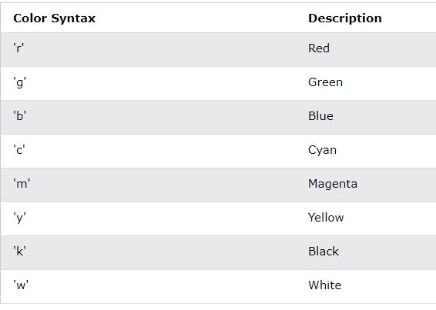

Slide 60
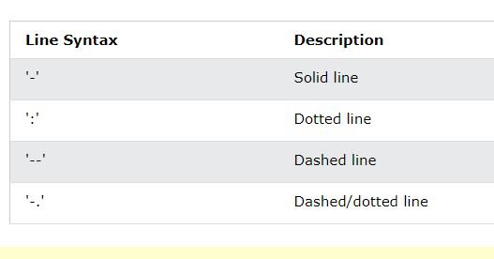

Slide 61
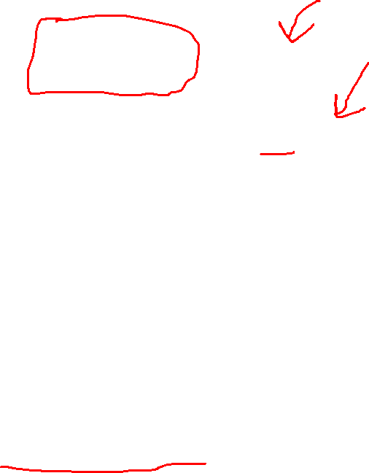
ms = markersize
mec = marker edge color
mfc = marker face color

